Slide 1
Soil Separation
Name
Date

Slide 2
About Me
Where I work
Job title
A little about me
Notes:
Hi, my name is __________________ and I work for ___________________ doing ____________________.
Introduce a little about yourself (Ex. You can share the town you live in, school you attended if local, highlight of the grade of the classroom you are in to make yourself relatable, something about your family, hobbies)
We will talk a little more about my career later.

Slide 3
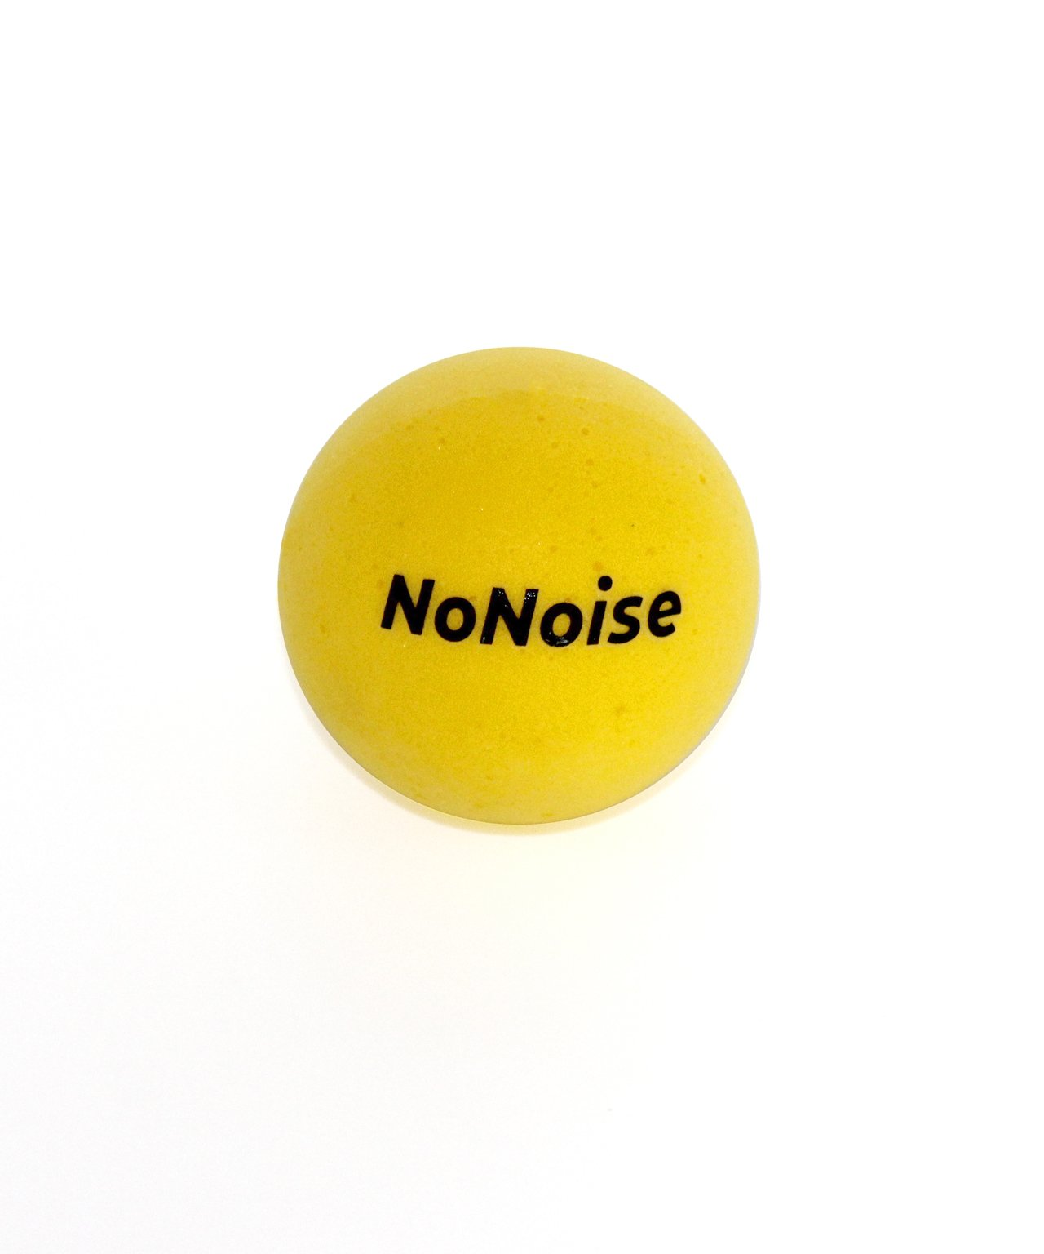
Notes:
Materials needed:
-3 clear, 12-oz clear plastic bottles or 5oz plastic cups with lids https://www.walmart.com/ip/Great-Value-Plastic-Snack-Cups-with-Lids-5-5-oz-20-Count/148337466
-10 oz each of potting soil, local soil, and sand (Try to obtain coarse sand similar to that used for home improvement projects. Clean, fine
sand may not allow water to pass as readily as most sands found in soils).
-Water
-Funnel (optional)
Prepare bottles at least one day before making observations.
Step 1: Fill each bottle about two-thirds full of soil. Place potting soil, local soil and sand in separate bottles. (A funnel or a paper cone may make it easier to get the soil in the bottles).
Step 2 : Add water to near the top of each bottle. Place caps on the bottles, shake the contents well, and place the bottles in a location where they will not be disturbed. Prepare at least one day before making observations.
**Optional: Divide into groups and have students make their own with the 5oz plastic cups.
**Be careful when transporting the bottles to try and not disturb the solutions that have already separated.
Today we are going to take a look at the different particles that make up soil. Do you think all soil is the same? Not all soil is created equal. Soil is made up of different particles that are categorized into three groups – sand, silt, and clay. If we were to look under a microscope, you’d see that those particles are each different sizes. Sand has the largest particles and clay has the smallest particles. If you look at the size differences on the screen, the volleyball represents sand, the tennis ball represents silt, and ping pong ball, which is much smaller, represents the clay.

Slide 4
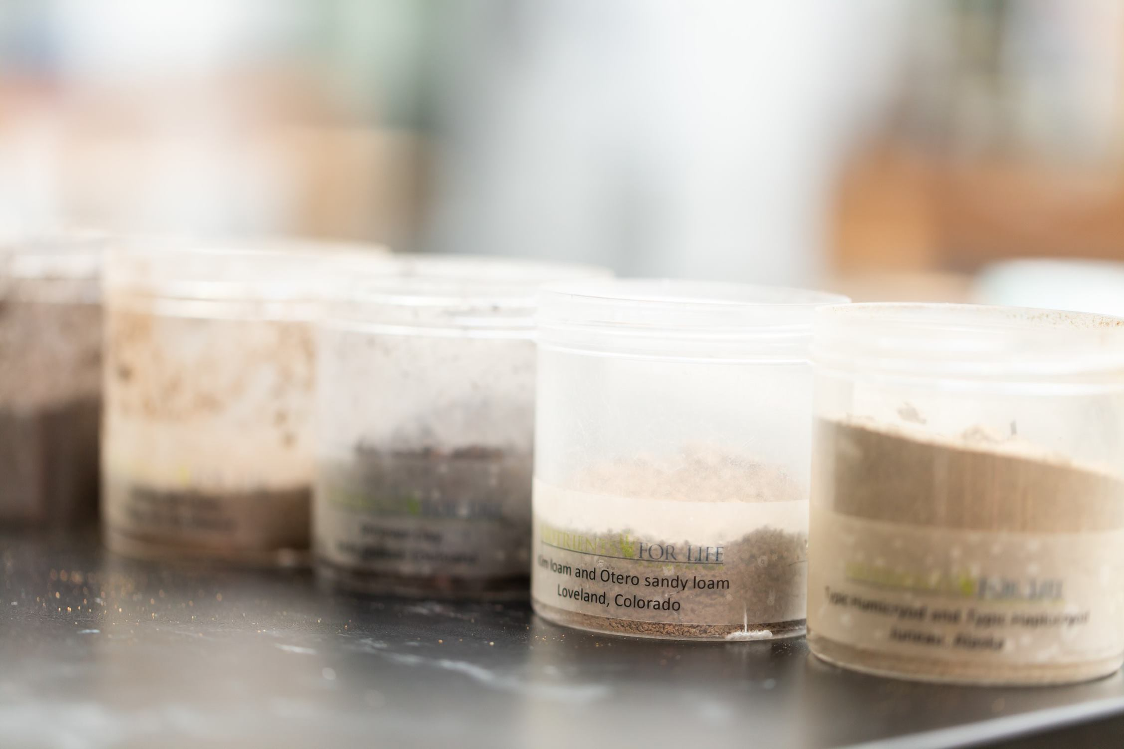
Notes:
Most soils are a combination of the three groups. The relative percentages of sand, silt, and clay are what give soil its texture. For example a clay loam texture soil has nearly equal parts of sand, slit, and clay. In this activity, you are going to observe three different soil types (potting soil, local soil and sand) that have been mixed with water and allowed to settle. In the demonstration, you will be able to see the different types of particles that make up the soil.

Slide 5
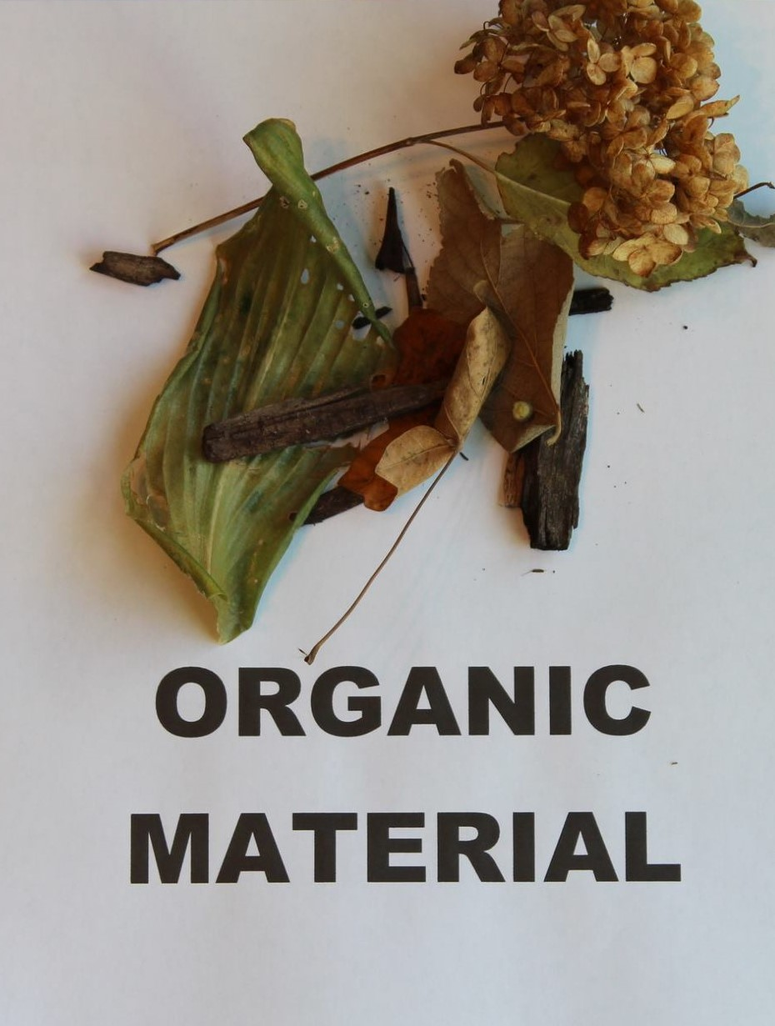
What is Organic Material?
Material from living or once living organisms.
Dead plant material, worms or decomposing insects
Notes:
Soil is also made up of organic matter. Does anyone know what organic matter is? Materials from living or once living organisms can be called organic matter. Some examples of this are dead plant material, worms, or decomposing insects.

Slide 6
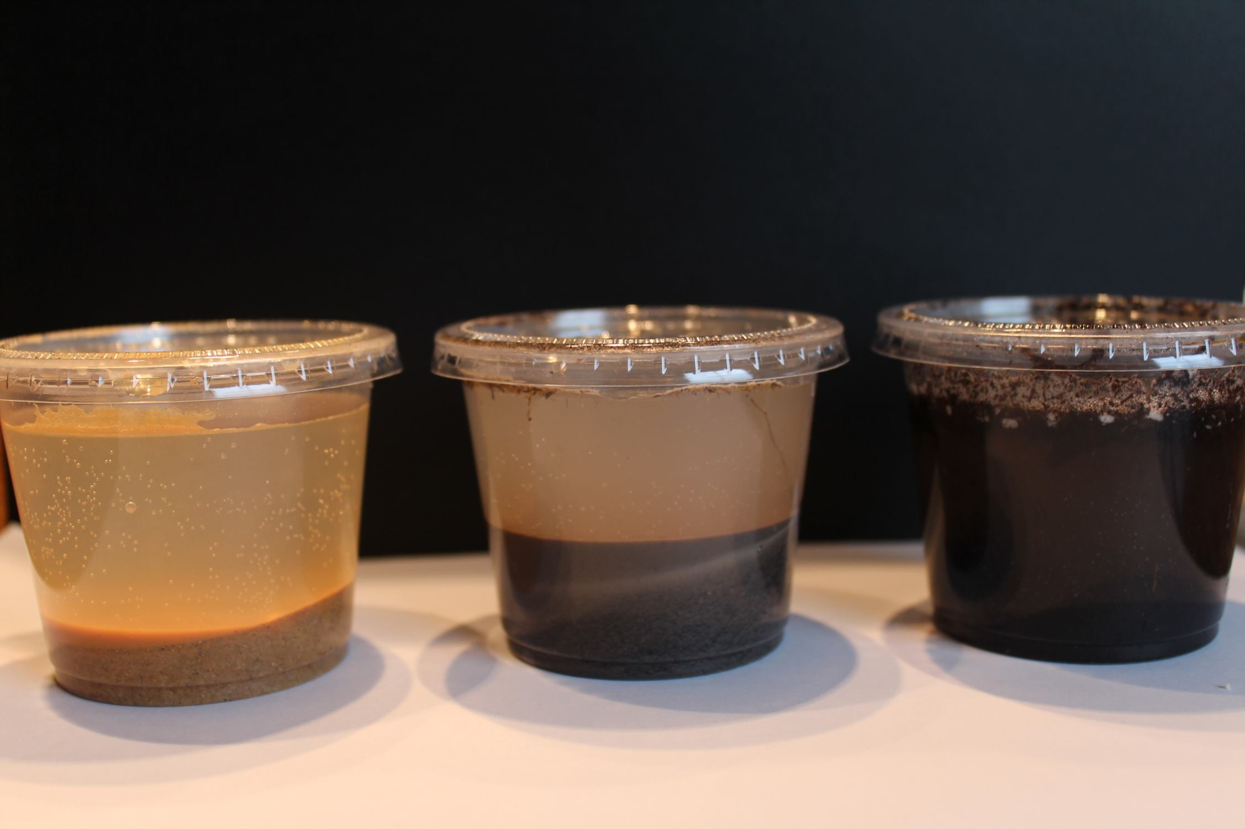
Notes:
These bottles of potting soil, local soil, and sand that were previously prepared with water and allowed to settle. Each bottle was about 1/3 full of potting soil, local soil or sand and water. I shook them up and allowed the soil to settle at the bottom. We are going to make some observations about the different types of soil.
**Optional break into groups and have each group make their own soil cups, using the 5oz cups, make sure they hold the lid tightly when shaking.
Let’s gather around the bottles here and make observations about the different soils.
Students will observe that the different soils separate differently. At this point, students will not know what is found in each layer.

Slide 7
Review
Can you identify the organic material in the water bottles?
Where do you see the organic material?
What could cause the differences in the color of water in each bottle?
Do you think each soil type will support plant growth equally?
Notes:
Can you identify the organic material in the water bottles?
-Soils contain both organic and inorganic material.
Where do you see the organic material?
-Organic material is less dense than inorganic material and floats to the surface of the water.
You’ll notice there is a difference in the color of the water in each water bottle.
What could cause the differences?
-The cloudiness in the water comes from inorganic particles called clay. They are so small that they can remain suspended in the water. Most of the nutrients in the soil is found in the organic mater and the clay.
Do you think each soil type will support plant growth equally?
- Most students will recognize that since soils differ in their amounts of organic material and clay, they will vary in their ability to support plant growth. Sand doesn’t hold water and nutrients because of their particle size. The water runs straight through, unlike clay which has extremely small particles that hold more water and nutrients. Because clay's particle size is so small, soils that contain a lot of clay have poor drainage. It is important to understand the differences in soil to make educated decisions.

Slide 8
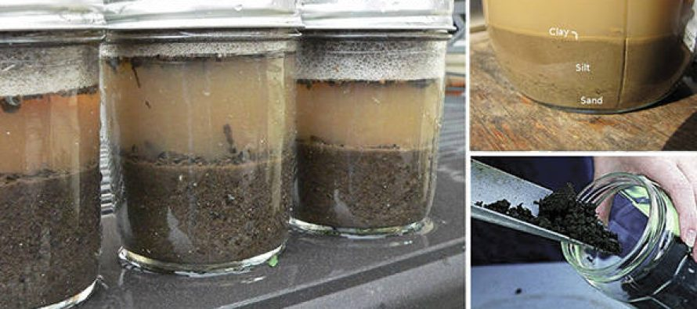
Notes:
You will notice the potting soil showed a thick layer of dark material on the bottom, a thick layer of cloudy water, and a thinner layer of organic material on the top.
Local soils may differ, but a typical soil will show layering similar to potting soil, though there may be less organic material floating on the surface. You will notice that the soil will form layers with sand settling to the bottom, silt in the middle and clay on top.
Most of the sand will form a very thick layer on the bottom of the container. There will be a thick layer of clear water and a very thin layer of material on the surface.

Slide 9
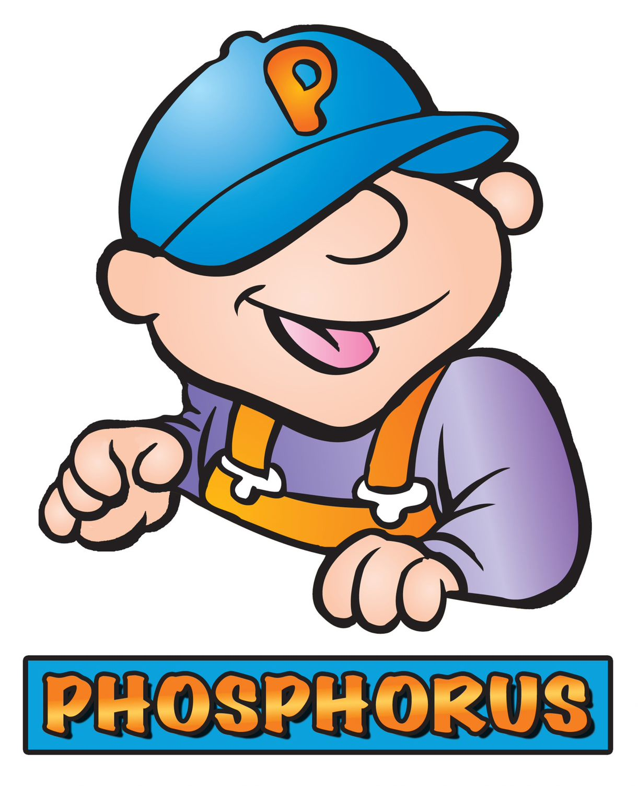
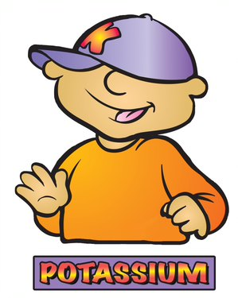
Notes:
We have been talking about the different particle sizes and the differences between sand, silt and clay, now lets take a brief look at the nutrients that plants need to grow and be healthy.
No matter what you grow, it needs the three primary nutrients N, P and K.
In science, we call nitrogen “N.” How do you think nitrogen helps plants? Plants need nitrogen to be green and healthy. Without nitrogen, plant leaves will be weak and yellow. Some plants require a lot of Nitrogen, so N is the first member of the NPK team.
The 2nd member of the team is P, which stands for Phosphorus. Without phosphorus the plant cannot conduct Photosynthesis. The leaves of a plant take in energy from the sun and turn it into energy for the plant. This is called photosynthesis. Phosphorus also helps encourage plants to grow strong and healthy roots, as well as helps the plant produce quality seeds, flowers, and fruit. Phosphorus can even help a plant resist disease, too.
Potassium, also called K, looks like a pink rock when it is mined. It’s mined either underground in the southeastern part of the United States or in the mountains in the northwest region. Potassium protects plants against diseases and helps the plants when it is cold or dry. It also helps the food you buy stay fresh.
How do farmers add these nutrients back to the soil if they are missing? Fertilizers! Every plant needs a specific amount of these nutrients, similar to a recipe when cooking. Some need more nitrogen, some need more phosphorus. Farmers send soil samples to agronomists, or a soil scientist, to find out how much fertilizer they need to add to their fields. They don’t want too little or their plants won’t grow well, and they don’t want too much because that could hurt their plants too. Farmers strive to be environmentally friendly, as well as economical.

Slide 10
Add some pictures of you doing your job/ the facility you work in.
Notes:
We talked a little earlier about my job title, but what is it that I actually do, and how does it relate to what we just learned about N, P, and K?
** Spend some time talking about your career, how it relates to Agriculture and the fertilizer industry. What do you do on a daily basis? What kind of education is needed to have a job like yours? Feel free to add additional slides and pictures to better explain your career.

Slide 11
QUEStionS?
Notes:
Ask students if they have any questions. You may also add contact information if you would like to be available to answer additional questions.

